Slide 1
ADVANCED LIGO “Het universum zingt voor mij”. –Dr. Siebren de Kuiper
MARIA VOLOSATOV
PHYSICS 325

Slide 2
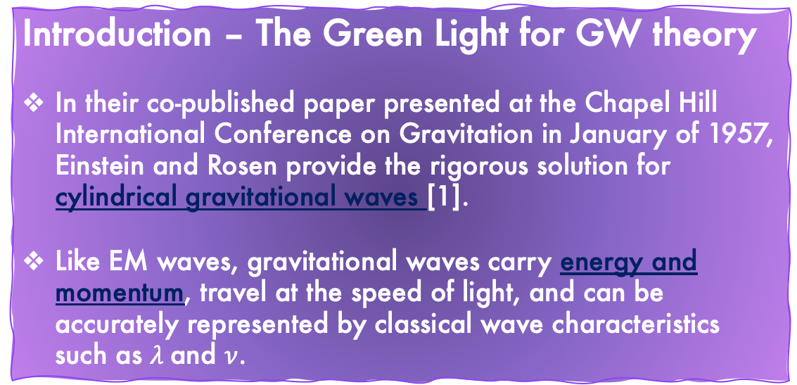
Introduction – The Green Light for GW theory
In their co-published paper presented at the Chapel Hill International Conference on Gravitation in January of 1957, Einstein and Rosen provide the rigorous solution for cylindrical gravitational waves [1].
Like EM waves, gravitational waves carry energy and momentum, travel at the speed of light, and can be accurately represented by classical wave characteristics such as $λ$and $ν$.
Fig. 1 refers to the four-dimensional continuum geometrically representing the spacetime interval that separates two events, denoted E, also described as Minkowski space.
Fig. 2. Signal from a stochastic gravitational wave source—like CMB radiation, stochastic GWs are a relic of the Big Bang. Like CMB, this noise ‘contaminates’ every region of the sky.

Slide 3
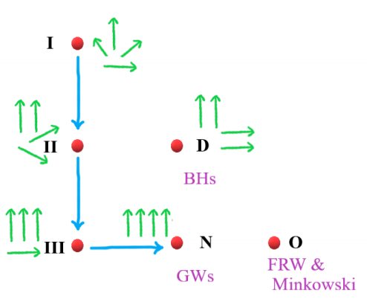
Fig. 4 - The green arrows represent the principle null directions. For O type, the Weyl tensor (blue) vanishes. The red dot is the source. [2]
Fig. 3 – left is for + GW and right is for x GW. Imagining a ring of particles, the effect of GWs on that ring polarized in the left direction, and the effect of GW’s on the ring polarized in the right direction will produce oscillations in a perpendicular plane.
Felix Pirani [1] contributed a paper in which he argued that gravitational radiation can be detected by analysis of the Riemann tensor, denoting an algebraic significance to this sort of radiation. His theory assigns principal null directions to distinct eigendirections, resulting in the arrangement of four Petrov types, II, III, D, and N. [2]
These symmetries, particularly D, are typically used for gravitational fields of massive objects in an isolated environment.

Slide 4
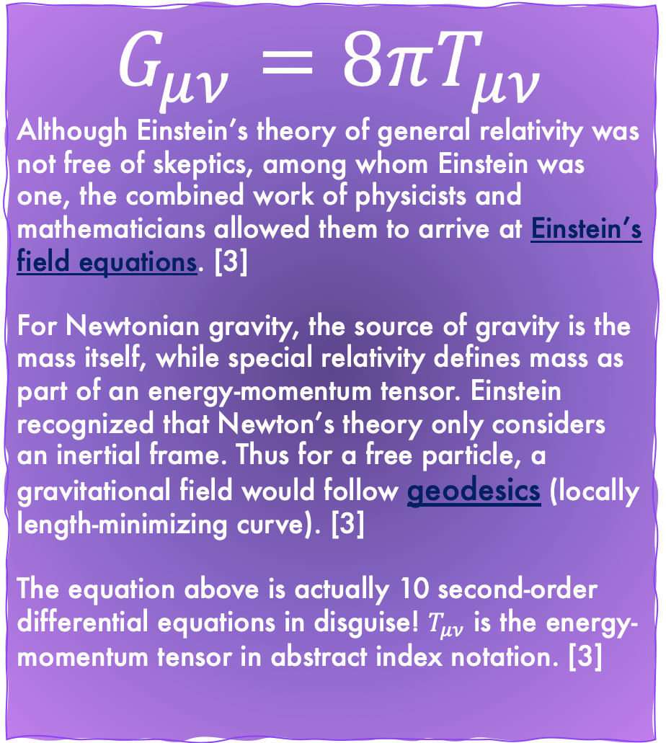
$$G_{μν}=8πT_{μν}$$
Although Einstein’s theory of general relativity was not free of skeptics, among whom Einstein was one, the combined work of physicists and mathematicians allowed them to arrive at Einstein’s field equations. [3]
For Newtonian gravity, the source of gravity is the mass itself, while special relativity defines mass as part of an energy-momentum tensor. Einstein recognized that Newton’s theory only considers an inertial frame. Thus for a free particle, a gravitational field would follow geodesics (locally length-minimizing curve). [3]
The equation above is actually 10 second-order differential equations in disguise! $T_{μν}$ is the energy-momentum tensor in abstract index notation. [3]
Fig. 5 - Here is the energy-momentum tensor, describing the density and flux of energy, and momentum in spacetime.

Slide 5
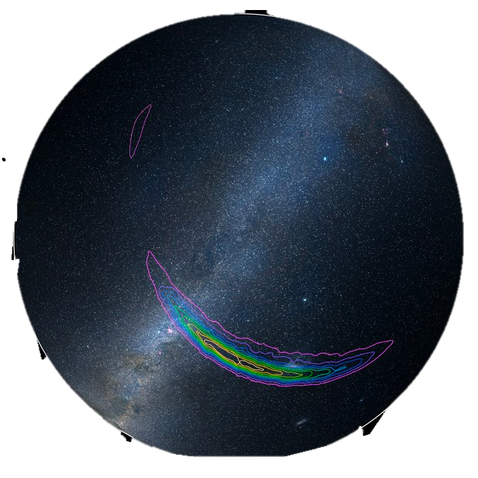
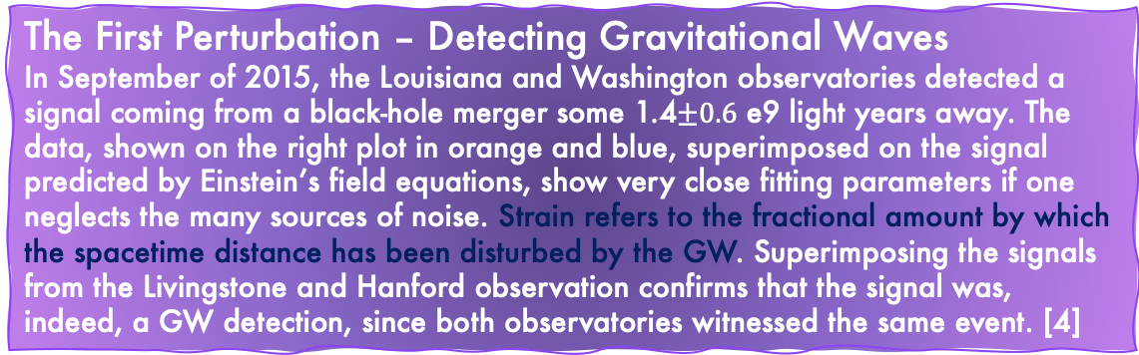
The First Perturbation – Detecting Gravitational Waves
In September of 2015, the Louisiana and Washington observatories detected a signal coming from a black-hole merger some 1.4$±0.6$ e9 light years away. The data, shown on the right plot in orange and blue, superimposed on the signal predicted by Einstein’s field equations, show very close fitting parameters if one neglects the many sources of noise. Strain refers to the fractional amount by which the spacetime distance has been disturbed by the GW. Superimposing the signals from the Livingstone and Hanford observation confirms that the signal was, indeed, a GW detection, since both observatories witnessed the same event. [4]
Fig. 6 – as can be seen from the predicted plot, the observations at both observatories follow the expected trend quite closely.
Fig. 7 – detected on 14th of September, 2015, the observation came from the region defined by the probability curves in the southern hemisphere, with purple being 90% confidence. The source is predicted to be coming from the direction of the Large Magellanic cloud.

Slide 6
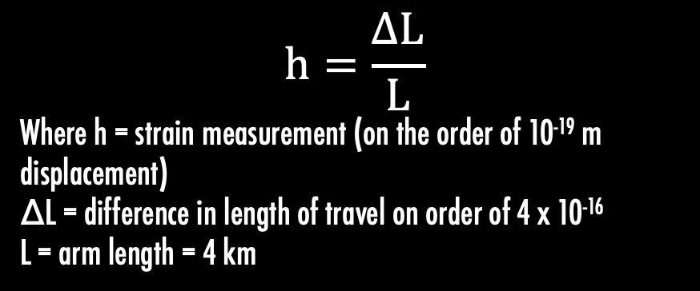
The Detector – Introduction of Advanced LIGO
The need for an incredibly sensitive device is achieved by interferometer-type gravitational wave detectors, among which LIGO is the most sensitive. GWs act freely on falling masses, which allows them to interact with the two suspended mirrors in a free-fall state, precision-crafted in order to measure the time taken for light to travel between them. A specialized Michelson interferometer acts as follows: a 220 Watt laser is shone through a beam splitter that divides the light into two beams travelling through the arms—each 4 km long running through an underground complex of gas-evacuated tubes—where the beams are allowed to bounce between the mirrors many times. The interference is then measured; theoretically, for no difference between the length of the arms, there should be no interference. But the slightest variation in the lengths of the arms will send the light to a photodetector, producing a measurement of strain.[5][6]
Fig. 8 – For varying amounts of light reaching the photodetector, the signal is converted to an electrical signal which can be quantified and data reduced. [5]
L – ∆L
L + ∆L
$$h=\frac{∆L}{L}$$
Where h = strain measurement (on the order of 10⁻¹⁹ m displacement)
∆L = difference in length of travel on order of 4 x 10⁻¹⁶
L = arm length = 4 km
~ h (strain)

Slide 7
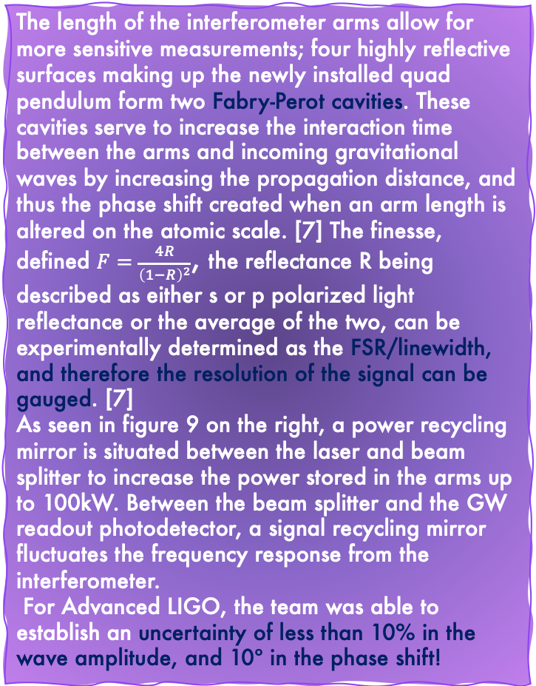
The length of the interferometer arms allow for more sensitive measurements; four highly reflective surfaces making up the newly installed quad pendulum form two Fabry-Perot cavities. These cavities serve to increase the interaction time between the arms and incoming gravitational waves by increasing the propagation distance, and thus the phase shift created when an arm length is altered on the atomic scale. [7] The finesse, defined $F=\frac{4R}{{\left(1−R\right)}^{2}}$, the reflectance R being described as either s or p polarized light reflectance or the average of the two, can be experimentally determined as the FSR/linewidth, and therefore the resolution of the signal can be gauged. [7]
As seen in figure 9 on the right, a power recycling mirror is situated between the laser and beam splitter to increase the power stored in the arms up to 100kW. Between the beam splitter and the GW readout photodetector, a signal recycling mirror fluctuates the frequency response from the interferometer.
For Advanced LIGO, the team was able to establish an uncertainty of less than 10% in the wave amplitude, and 10º in the phase shift!

Slide 8
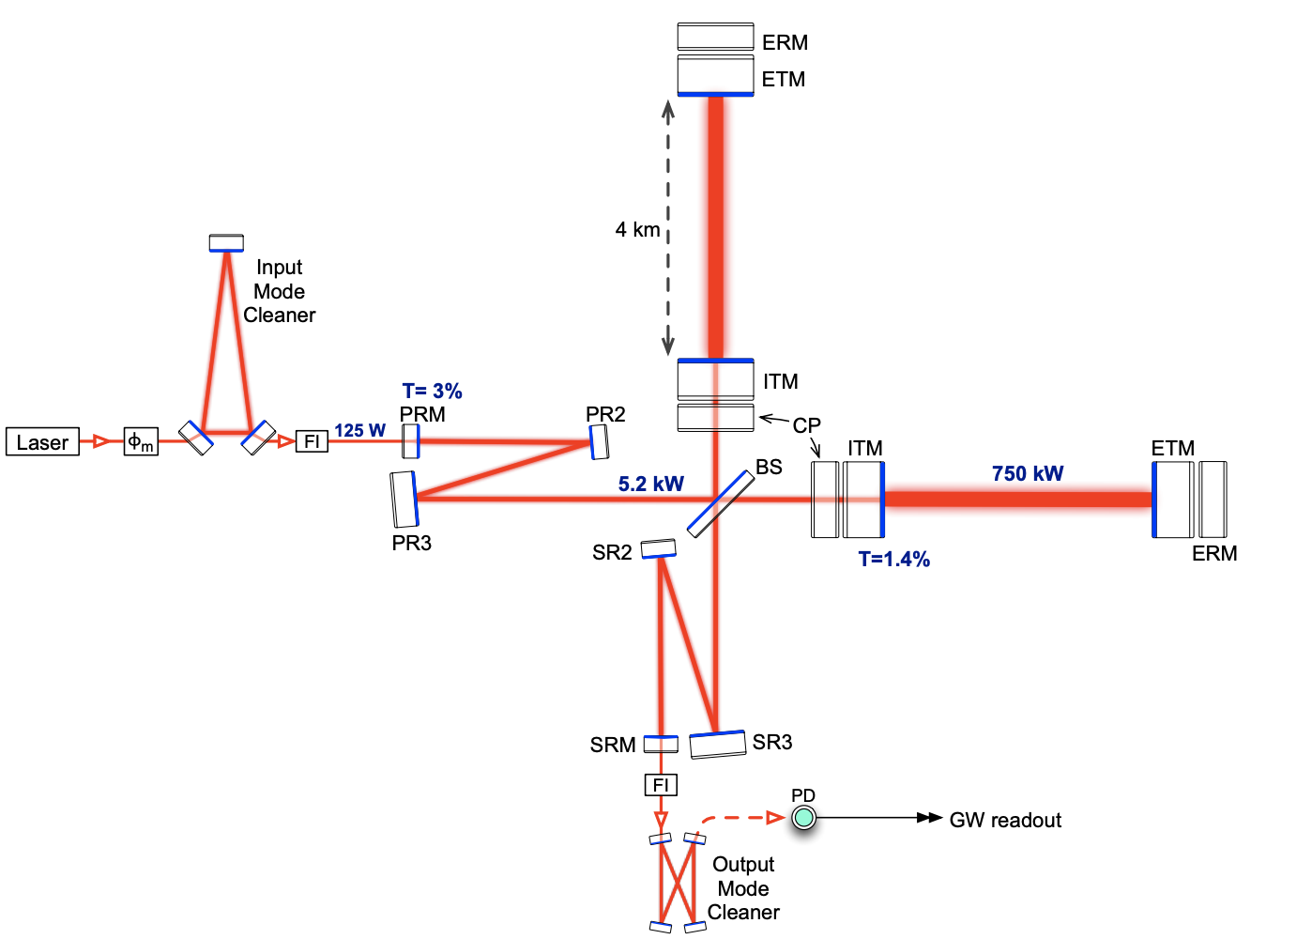
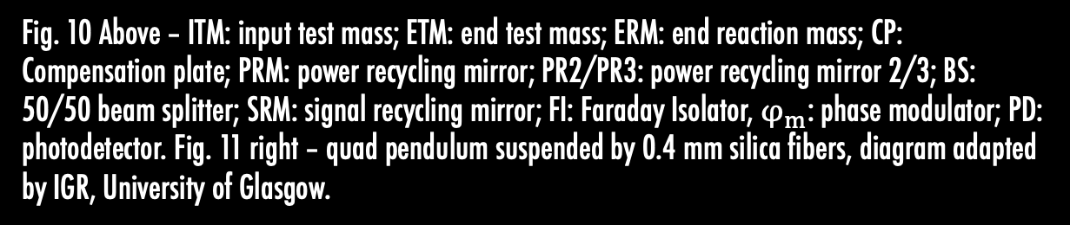
Fig. 10
Fig. 11
Metal masses
Main chain side
Penultimate mass
Reaction mass
Fig. 10 Above – ITM: input test mass; ETM: end test mass; ERM: end reaction mass; CP: Compensation plate; PRM: power recycling mirror; PR2/PR3: power recycling mirror 2/3; BS: 50/50 beam splitter; SRM: signal recycling mirror; FI: Faraday Isolator, $φ_{m}$: phase modulator; PD: photodetector. Fig. 11 right – quad pendulum suspended by 0.4 mm silica fibers, diagram adapted by IGR, University of Glasgow.

Slide 9
Limiting Noise
An ultra-sensitive detector such as aLIGO is naturally subjected to many different sources of noise. Peaking design sensitivity constraints, the dominant noise source tends to be quantum noise. Individual photons arriving at the reflective surface fluctuate and obey Poisson statistics [8], and at the point of photodetection, the fluctuations are generally considered shot noise. Quantum radiation pressure noise (QRPN) is produced due to momentum transfer to the test mass, perturbing its position [8]. Among propositions for reducing the effects of QRPN, techniques such as the injection of squeezed light---that is, a squeezed coherent state—into the system, variational readout, conditional squeezing, and use of negative mass systems have all been proposed to improve the sensitivity at lower frequencies.
Fig. 12 (left) – noise spectrum of squeezed light measured at reflection port of optomechanical cavity.
Fig . 13 (top right) – Displacement spectral density of micro resonator with 140 kHz optical spring resonance, and other noise sources. As can be seen, QPRN dominates below optical spring resonance. Greatest contribution at higher frequencies come from thermal & quantum noise. Fig. 14 (right) – calibrated displacement noise spectrum.

Slide 10
A summary of improvements from Initial LIGO to Advanced LIGO [9]
Initial LIGO | Advanced LIGO
Test masses - 25 cm in diameter, 10 cm in girth, 11 kg. | Test masses – 34 cm in diameter, 20 cm in girth, 40 kg. Noise reduced via principal of inertia: increasing size and mass of mirrors reduces photon shot noise & increase area over which heat can be absorbed from laser, diminishing thermal noise.
Single pendulum system suspended by metal wires – composition of metal introduced additional noise to mirror. | Quadruple pendulum suspended by glass fibers. Silica fibers structure less energetic, more structured than metal, reducing noise. Increased interaction time between mirrors.
Passive seismic isolation system – shock absorbers surrounding detectors to reduce vibrations. | Passive and active seismic isolation system – additionally to the passive system, sensors monitoring movements create a live feedback loop, using photon radiation pressure actuators to counteract vibrations both from seismic sources and quantum sources.
“Sphere of observation” reaches edge of Centaurus supercluster, approximately 15 Mpc. | 10 x increase in distance, 1000 increase in observable volume, sources 1.3 billion light years away are detectable (!!!) approximately 300 Mpc.
Fig. 15 (left) – Sphere of observation comparison between initial & advanced LIGO, the new probe encompasses 1000 x the volume of initial LIGO! This opens the window to sources many millions of light years away in the depths of the cosmos.
Fig. 16 (right) – compares the detectable strain, h, over a spectrum of frequencies in LIGO vs aLIGO. Lower numbers of strain indicate smaller distances detected.

Slide 11
New Horizons
As with the implementation of radio astronomy, an entirely new regime of observations was made available, allowing astronomers to find cosmic objects that have until then been hidden from the relatively narrow spectrum perceivable by the human eye. In 1993, the Nobel Prize in Physics was awarded to Russell Hulse and Joseph Taylor for the discovery of a pulsar binary (PSR 1913 + 16), which they correctly identified as a major source of gravitational waves, the energy loss causing the stars to converge [10].
Fig. 17 (above) – an artist’s impression of a merger event between two neutron stars. Neutron stars are the result of a core collapse of a giant star, creating an environment so dense that protons and electrons are combined into neutrons (hence the title). While binary stars don’t necessarily reach the threshold of mass and density require to make a black hole—an object so incredibly dense that even light cannot escape its gravitational grasp—the two entities can form binary systems. In orbiting one another, they accelerate, producing gravitational waves (the wispy arms in the diagram), and as the objects near a merging event, the magnitude of the waves becomes more immense—and more likely to be observed from astronomical distances by aLIGO! [11]
Fig. 19 – Pulsars are rotating neutron stars with incredibly strong magnetic fields, creating jets of particles along the axis of the star’s poles, which accelerate and produce the streams of light you see on the left. In astronomy, pulsars are used to gauge distances. A closer study of these incredible objects can be achieved with aLIGO. [13]
Fig. 18 – a composite image of the Supernova 1987A (SN1987A) event, the nearest Supernova event that happened in modern astronomy captured by NASA’s Chandra X-ray Observatory, the Hubble Space Telescope, and at submillimeter wavelength at the ALMA telescope array in Chile. Supernovae are known to produce high-frequency GW bursts that may be detectable by aLIGO. Among some of the prevailing theories in astrophysics is the Cosmic String theory, introduced by Sir Tom Kibble. If GWs were to be detected from such an event, it would suggest axial symmetry, confirming the existence of cosmic strings. [12]

Slide 12
References
[1] “The Mathematics of Gravitational Waves”, introduction by C. Sormani, “Part One: How the Green Light was Given for GW search”, C. Denson Hill and Paweł Nurowski, “Part Two: GWs and Their Mathematics”, Lydia Bieri, David Garfinkle, & Nicolás Yunes, Notices of the AMS, https://www.ams.org/journals/notices/201707/rnoti-p684.pdf
[2] MPA Lectures on Gravitational Waves in Cosmology, Azadeth Maleknejad, Max-Plank-Institute for Astrophysics, Karl-Schwarzchild-Str. 1, 85741 Garching, Germany, https://wwwmpa.mpa-garching.mpg.de/~komatsu/lecturenotes/Azadeh_Maleknejad_on_GW.pdf
[3] ”The Basics of Gravitational Wave Theory”, Éanna É Flanagan and Scott A Hughes, Center for Radiophysics and Space Research, Cornell University, NY, Department of Physics and Center for Space Research at MIT, 5th Oct. 2005. https://arxiv.org/pdf/gr-qc/0501041.pdf
[4] LIGO Caltech, Gallery, February 11, 2016, LIGO, https://www.ligo.caltech.edu/image/ligo20160211a
[5] “Gravitational Waves: Ripples in the fabric of space-time”, MIT LIGO, Cambridge, https://space.mit.edu/LIGO/more.html
[6] LIGO document no. LIGO-P1400177, “Advanced LIGO”, https://arxiv.org/pdf/1411.4547.pdf
[7] “LIGO – Treating Gravitational Events Lightly”, P. Derek Bradshaw, University of Arizona-College of Optical Sciences, https://www.optics.arizona.edu/sites/optics.arizona.edu/files/p-derek-bradshaw-msreport.pdf
[8] “Broadband reduction of quantum radiation pressure noise via squeezed light injection”, Min Jet Yap et al., Nature photonics, Letters, vol 14, January 2020, 19-23, https://www.nature.com/articles/s41566-019-0527-y
[9] “About aLIGO”, LIGO Caltech, https://www.ligo.caltech.edu/page/about-aligo
[10] Stephen T. Thornton, Andrew Rex, Modern Physics for Scientists and Engineers, Fourth Edition, Chapter 15, “General Relativity”, Cengage Learning, 2013
[11] ”A Search for Gravitational Waves from Inspiralling Neutron Stars and Black Holes”, LIGO Scientific Collaboration, https://www.ligo.org/science/Publication-S6CBCLowMass/
[12] ”Do Cosmic Strings Exist?”, LIGO Scientific Collaboration, https://www.ligo.org/science/Publication-S5S6CosmicStrings/flyer.pdf
[13] “How High are Pulsar ’Mountains’?”, LIGO Scientific Collaboration, https://www.ligo.org/science/Publication-S6VSR24KnownPulsar/

Slide 13
Images
Fig 1. Minkowski Light Cone: https://physics.stackexchange.com/questions/2308/example-of-space-like-intervals-in-spacetime
Fig 2. Stochastic GW source: https://www.ligo.org/science/GW-Stochastic.php
Fig 3. Polarized GW, figure provided by Kip Thorne from original publication: https://iopscience.iop.org/article/10.1088/1367-2630/7/1/204
Fig 4. Petrov Classification of the Weyl Tensor: https://wwwmpa.mpa-garching.mpg.de/~komatsu/lecturenotes/Azadeh_Maleknejad_on_GW.pdf
Fig 5. Stress shear tensor: https://en.wikipedia.org/wiki/Stress%E2%80%93energy_tensor
Fig 6. First Gravity Wave detection data, Caltech/MIT/LIGO Lab: https://www.ligo.caltech.edu/image/ligo20160211a
Fig 7. Source of Waves, LIGO/Axel Mellinger: https://www.ligo.caltech.edu/image/ligo20160211b
Fig 8. Basic Interferometer Schematic: https://space.mit.edu/LIGO/more.html
Fig 9. Advanced LIGO Interferometer: https://www.ligo.org/science/Publication-GW150914Calibration/index.php
Fig 10. LIGO document no. LIGO-P1400177, figure 1: https://arxiv.org/pdf/1411.4547.pdf
Fig 11. aLIGO quadruple pendulum: https://www.ligo.caltech.edu/page/about-aligo
Fig 12. Broadband Reduction of QRPN via Squeezed Light, Fig 2: Low-frequency squeezed light: https://www.nature.com/articles/s41566-019-0527-y
Fig 13. Broadband Reduction of QRPN via Squeezed Light, Fig 3: Noise budget: https://www.nature.com/articles/s41566-019-0527-y
Fig 14. Broadband Reduction of QRPN via Squeezed Light, Fig 4: Manipulation of QPRN with squeezed light: https://www.nature.com/articles/s41566-019-0527-y
Fig 15. Initial vs Advanced LIGO: https://www.researchgate.net/figure/Advanced-LIGO-sensitivity-vs-LIGO-one_fig1_29633553
Fig 16. LIGO observing sphere comparison: https://www.ligo.caltech.edu/page/facts
Fig 17. Orbiting Neutron Stars: https://www.ligo.org/science/Publication-S6CBCLowMass/
Fig 18. SN 1987A: https://chandra.harvard.edu/photo/2017/sn1987a/
Fig 19. Pulsar: https://rascto.ca/content/uoft-astrotour-sensing-hidden-signals-pulsars

